Slide 1
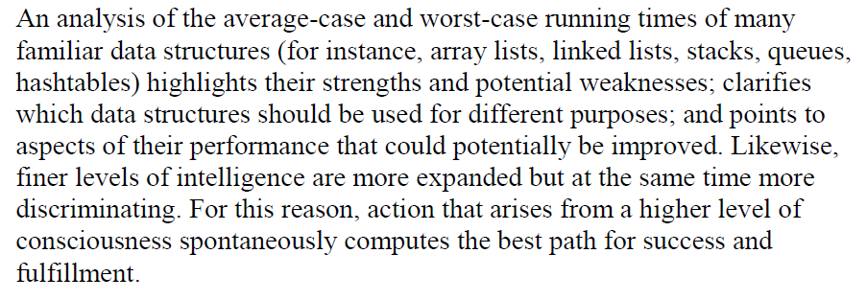
Lesson 8
Data Structure Review
: Fully Developing the Container of Knowledge
Wholeness of the Lesson
Notes:
Radish-Sort

Slide 2
Dynamic Sets
Now we will focus on data structures rather than straight algorithms
In particular, structures for dynamic sets
  Elements have a key and satellite data
  Dynamic sets support queries such as:
    Search(S, k), Minimum(S), Maximum(S), Successor(S, x), Predecessor(S, x)
  They may also support modifying operations like:
    Insert(S, x), Delete(S, x)

Slide 3
Dynamic Sets
What is Dynamic Set?
  Mathematical sets are unchanging
  BUT sets used in computers can grow or shrink i.e. they are DYNAMIC.
  Will talk about algorithms to manipulate such Dynamic sets.
Most common operations will be INSERT, DELETE and SEARCH – Sets supporting these are usually Called DICTIONARY.

Slide 4
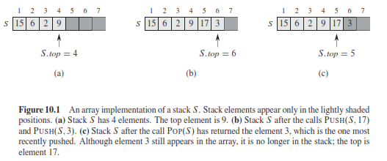
Stacks
Stack - LIFO (Last in First Out)
Queue – FIFO (First in First Out)
These can be implemented using Arrays

Slide 5
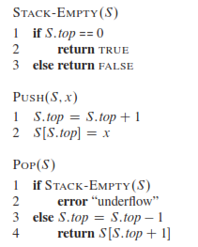
Stacks
Common Operations on a Stack

Slide 6
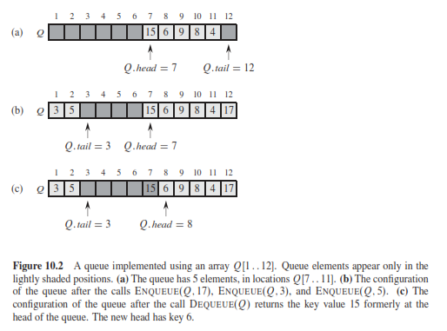
Queue

Slide 7
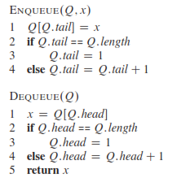
Queue

Slide 8
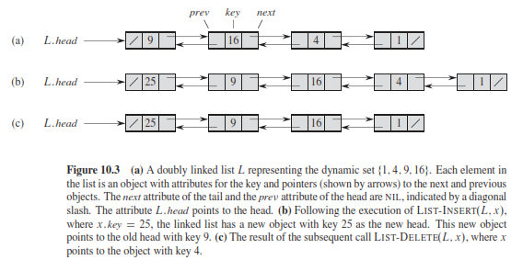
Linked List

Slide 9
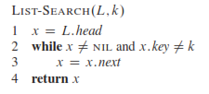
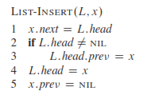
Linked List

Slide 10
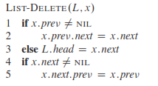
Linked List

Slide 11
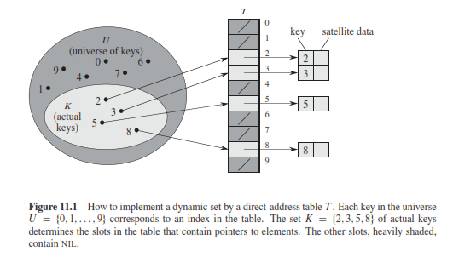
Hashing
Direct Address table

Slide 12
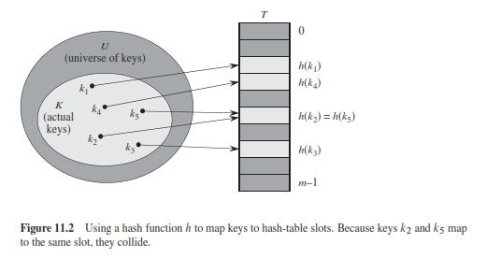
Hashing
Hash table

Slide 13
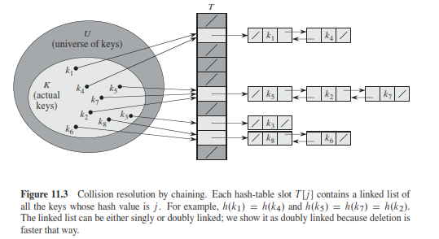
Hashing
Collisions and How to Avoid Them

Slide 14

Hash Functions
Functions that Calculate Hash address using the values of the keys
  Division Method (m is the number of slots in hash table]
  Say m=12, k = 100, h(k) = ?
  Multiplication Method
  kA mod 1 means fractional part of kA i.e. kA-floor of kA
  Universal Hashing

Slide 15
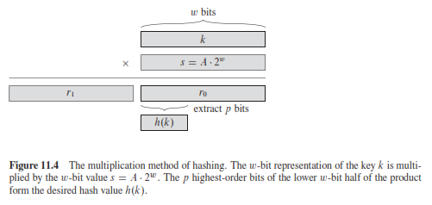
Hash Functions
More on Multiplication Method
  A is between 0 and 1. Optimal value is 0.618!

Slide 16
Multiplication Method -Example
If 0 < A < 1, h(k) = ⎣m (kA mod 1)⎦ = ⎣m (kA – ⎣kA⎦) ⎦
where kA mod 1 means the fractional part of kA, i.e., kA – ⎣kA⎦.
Disadvantage: Slower than the division method.
Advantage: Value of m is not critical.
  Typically chosen as a power of 2, i.e., m = 2^{p}, which makes implementation easy.
Example: m = 1000, k = 123, A ≈ 0.6180339887…
h(k) = ⎣1000(123 · 0.6180339887 mod 1)⎦
= ⎣1000 · 0.018169... ⎦ = 18.

Slide 17
Hash Functions – Universal Hashing
For Division or Multi. Method, the worst case is that all keys map to ONE Slot!
To avoid so, Universal hashing selects hash functions randomly.
The key idea is to select Hash Function at random at run time from set of selected functions.
This provides good average case performance.

Slide 18
Hash Functions – Universal Hashing
H – finite collection of hash functions that maps Universe U to keys in the range [0,1,2, m-1].
If the Number of hash functions h, for which h(x) = h(y) is |H| / m , then
H is a Universal Hash Function.
Chance of collision between x and y is 1/m.

Slide 19
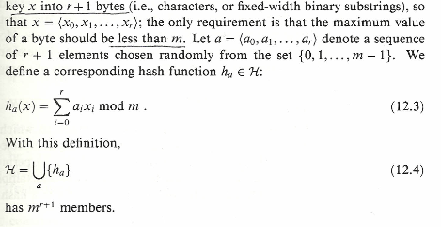
Hash Functions - Universal Hashing
Decompose

Slide 20
Universal Hashing – Key Notes
A hash function is selected at random (from the family of hash functions) at run time.
This means that one hash function is used for that run time. Next run time, another hash function used for all keys (if a hash function causes too many collision, the program can possibly rerun using another hash function).
Thus, on the average for several runs, the collision is minimized.
To find a key, use the same hash function to calculate the address and get the data from that address.

Slide 21
Example
Let m = 5, and the size of each string is 2 bits (binary). Note the maximum value of a string is 3 and m = 5
a = 1,3, chosen at random from 0,1,2,3,4
Example for x = 4 = 01,00 (note r = 1)
h_{a}(4) = 1 × (01) + 3 × (00) = 1 Mod 5 = 1
  [Note 01 and 00 need to be converted to decimal]
  NOTES: - Pick r based on m and the range of keys in U
  - Remember – Total # of Hash Function = m**(r+1)
  - Probability of Collision = 1/m (why?)

Slide 22
Proof for Collision pr. 1/m

Slide 23
About Inverse Modulo
Given two integers ‘x’ and ‘m’, find modular multiplicative inverse of ‘x’ under modulo ‘m’.
The modular multiplicative inverse is an integer ‘x’ such that.
A . X = 1 mod (M)
Example:
Input: X = 3, m = 11, Output: 4. Since (4*3) mod 11 = 1,
4 is modulo inverse of 3(under 11).

Slide 24
Keys as Natural Numbers
Hash functions assume that the keys are natural numbers.
When they are not, have to interpret them as natural numbers.
Example: Interpret a character string as an integer expressed in some radix notation. Suppose the string is CLRS:
  ASCII values: C=67, L=76, R=82, S=83.
  There are 128 basic ASCII values.
  So, CLRS = 67·128³+76 ·128²+ 82·128¹+ 83·128⁰ = 141,764,947.

Slide 25
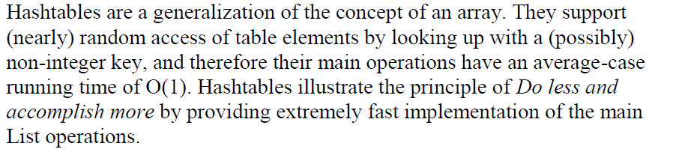
Main Point – Hash Table

